Slide 1
A Computational Approach to Edge Detection
John Canny
Aaron Styx

Slide 2
3 Main Goals for Edge Detector
Low error rate
Well localized edges
Prevent multiple detection of single edge

Slide 3
One-Dimensional Formulation
Assumptions
  2D edges have constant local cross-section in some direction
  White Gaussian noise
Detection Process
  Begin with edge
  Convolve edge with filter
  Mark center of edge at local maximum in convolution output

Slide 4
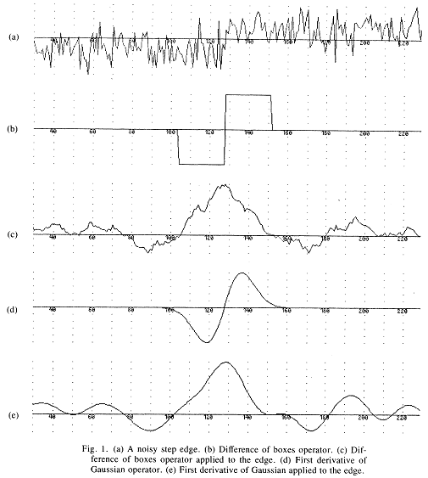
Detection
Image from Ref. 1

Slide 5
Performance Criteria
Problem becomes finding the filter that gives best performance
Performance with respect to:
  1 – Good Detection
    Achieved by Maximizing the signal-to-noise ratio
  2 – Good Localization
  3 – Only one response to single edge

Slide 6
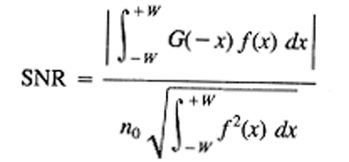
Mathematical Forms – Detection
Signal-to-noise ratio
  Impulse response of filter = f(x)‏
  Edge = G(x)‏
  Assume edge centered at x = 0

Slide 7
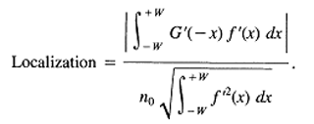
Localization
Measure should increase with improved localization
Use reciprocal of root-mean-squared distance of marked edge from true edge

Slide 8
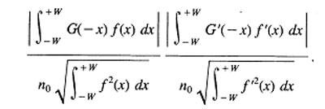
Combination of SNR & Localization
Want to maximize both the signal-to-noise ratio and the localization
Maximize product of SNR and Localization

Slide 9
Eliminating Multiple Responses
Essentially need to limit the number of peaks in the response to a single edge
“Make the distance between peaks in the noise response approximate the width of the response of the operator to a single step.”
Width = some fraction of operator width W.

Slide 10
Finding Optimal Detectors by Numerical Optimization
Hard to find closed form function f of SNR Localization product that satisfies multiple response constraint
Evaluation of given function is easy
Use a penalty function that is non-zero when constraints are violated
Find f that maximizes:
Output is an implementation of a detector

Slide 11
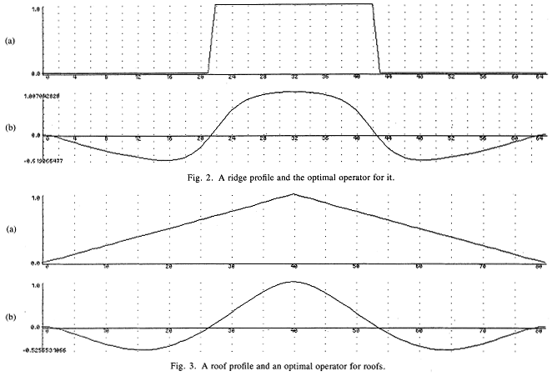
Source Ref. 1

Slide 12
Detector for Step Edges
Specialize previous results for step edges
Found that:
  Filter with broad impulse response will have better SNR
  Filter with narrow impulse response will have better localization
Cannot improve both SNR and Localization simultaneously
Product of SNR and Localization equations is a natural choice

Slide 13
Want to take the smallest operator that has output signal-to-noise ratio above certain threshold
Probability of spurious maximums is calculated
Optimal detector is found but not the final solution. Tradeoffs still exist.

Slide 14

An Efficient Approximation
The operator derived can be approximated by first derivative of a Gaussian G'(x) where
Reason: Can easily compute 2D extension of the filter if it is represented as a derivative of a Gaussian
20% worse – Not generally noticeable
Better approximations exist, but harder to work with, especially with texture

Slide 15
Two Dimensions
In 2D edges also have direction
  Edge direction is the direction of the tangent
To detect edges in a certain direction, a 2D mask is created
  Convolve a linear edge detection function with a projection function parallel to the edge direction
Can be improved
Other Methods

Slide 16
Need Multiple Widths
Choose width that gives best detection/localization tradeoff
SNR varies for each edge, therefore need different widths
Widths must be made automatically by the system
Feature synthesis approach
  Start with small operator output, from which the large operator outputs are synthesized
  Results from large operator compared to synthesized. Only accepted if significantly greater

Slide 17
References
J. Canny, “A Computational Approach to Edge Detection”, IEEE Trans. Pattern Analysis and Machine Intelligence, Vol. 8, No. 6, pp. 679-698, 1986.

